Slide 1


Slide 2

INTRODUCTION Blockchain

Slide 3
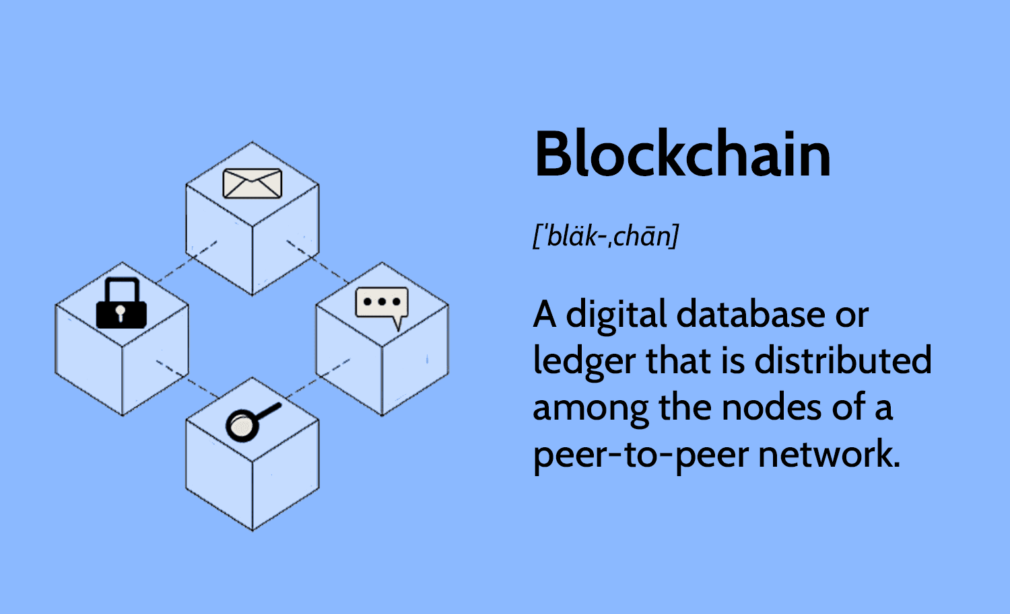

Slide 4

Blockchain is a distributed ledger
technology that enables
the secure and transparent recording
of transactions across a
network of computers.
In this system,data is stored in blocks,
each containing a collection of transactions.

Slide 5
These blocks are linked chronologically in
a chain through cryptographic hashes,
ensuring the integrity and immutability
of the recorded information.
This decentralized structure eliminates
the need for a central authority, allowing
participants to verify and audit transactions independently.

Slide 6


Slide 7

The conceptual foundation of blockchain dates back to 1991
when researchers Stuart Haber and W. Scott Stornetta introduced a computational solution
for time-stamping digital documents to prevent backdating or tampering. In 1992, they incorporated
Merkle trees into their design, enhancing efficiency by allowing multiple documents to be grouped within a single block.

Slide 8


Slide 9
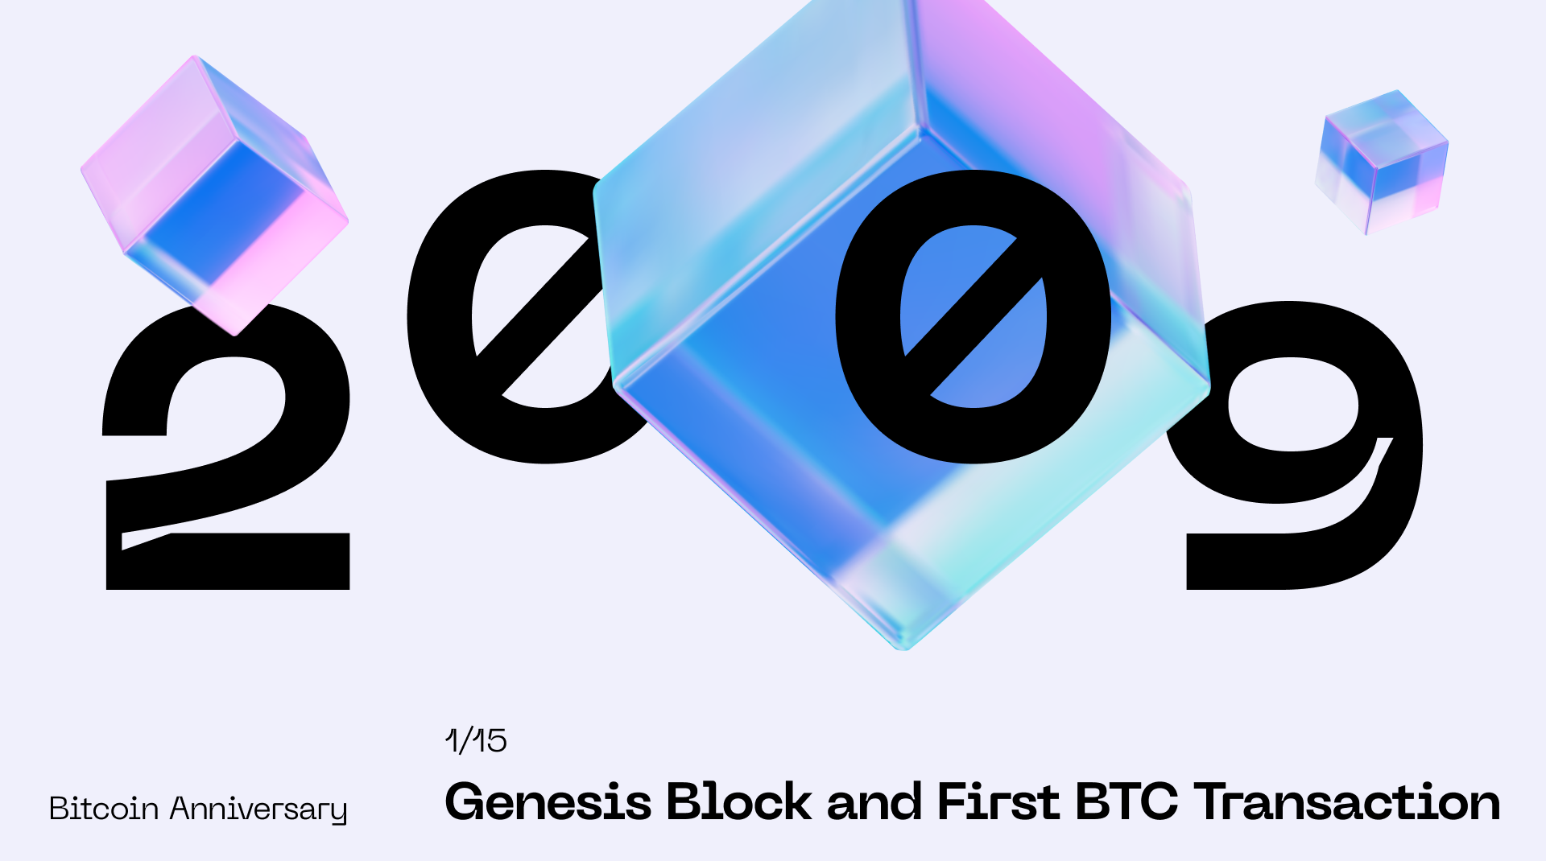

Slide 10

The first practical implementation of blockchain emerged in 2009
with the launch of Bitcoin by an anonymous entity known as Satoshi Nakamoto.
Bitcoin utilized a blockchain to serve as a public ledger for all transactions within its
network,
effectively solving the double-spending problem without the need for a trusted central authority.
This innovation laid the groundwork for subsequent applications and
adaptations of blockchain technology across various sectors.

Slide 11
Features of Blockchain

Slide 12
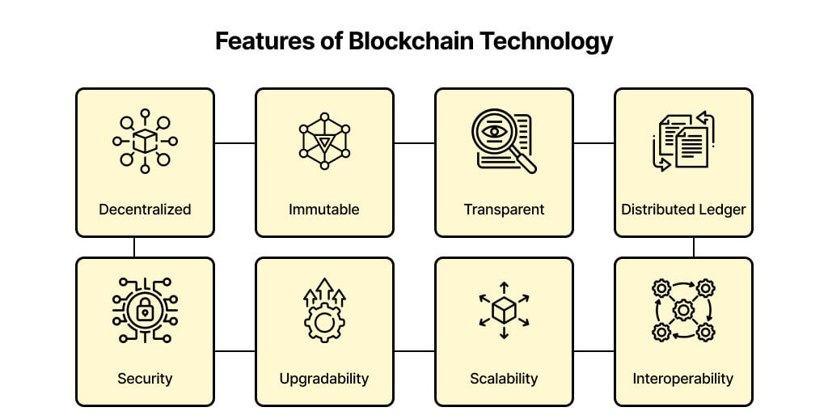

Slide 13
Decentralization:
Unlike traditional centralized systems, blockchain operates on a decentralized network of nodes,
eliminating the need for a central authority. This structure enhances system reliability and
reduces the risk of single points of failure.

Slide 14
Immutability: Once data is recorded on the blockchain, it cannot be altered or deleted. This immutability ensures the integrity and trustworthiness of the information stored.

Slide 15
Transparency: All transactions on a public blockchain are visible to all participants, promoting accountability and trust within the network.

Slide 16
Security: Blockchain employs advanced cryptographic techniques to secure data, making it highly resistant to fraud and cyberattacks.

Slide 17
Consensus Mechanisms: Blockchain networks utilize consensus algorithms, such as Proof of Work (PoW) or Proof of Stake (PoS), to validate transactions and maintain the integrity of the ledger.

Slide 18
BLOCKCHAIN FUNDAMENTALS

Slide 19
Cryptography and Hashing in Blockchain
Blockchain technology relies heavily on cryptography to ensure the security, integrity, and immutability of its data. A fundamental aspect of this cryptographic foundation is the use of hash functions.

Slide 20
Cryptographic Hash Functions
A cryptographic hash function is an algorithm that transforms input data of any size into a fixed-size string of characters, typically a hexadecimal number. This output, known as a hash, is unique to each unique input; even a minor change in the input data results in a significantly different hash. This property is crucial for verifying data integrity, as any alteration in the original data will produce a different hash, signaling tampering.

Slide 21
Common Hash Functions in Blockchain
Several cryptographic hash functions are utilized in blockchain technology:
SHA-256: Used extensively in Bitcoin and other cryptocurrencies, SHA-256 produces a 256-bit hash value and is known for its security and reliability.
SHA-3: The latest member of the Secure Hash Algorithm family, offering enhanced security features.
Blake3: Known for its speed and security, Blake3 is gaining attention for its efficient performance.

